Slide 1

TeamWork project: Hangman
variables
While-Loop
While-Loop
Intro
Intro screen
Choose difficulty level
Game play
“quit”
invalid input
repeated input
correct input
wrong input
Game Win
Game Over
functions
Friday, November 4th 2022
Slide <number>
Zinaida Jusufovic
Thomas Sicay

Slide 2
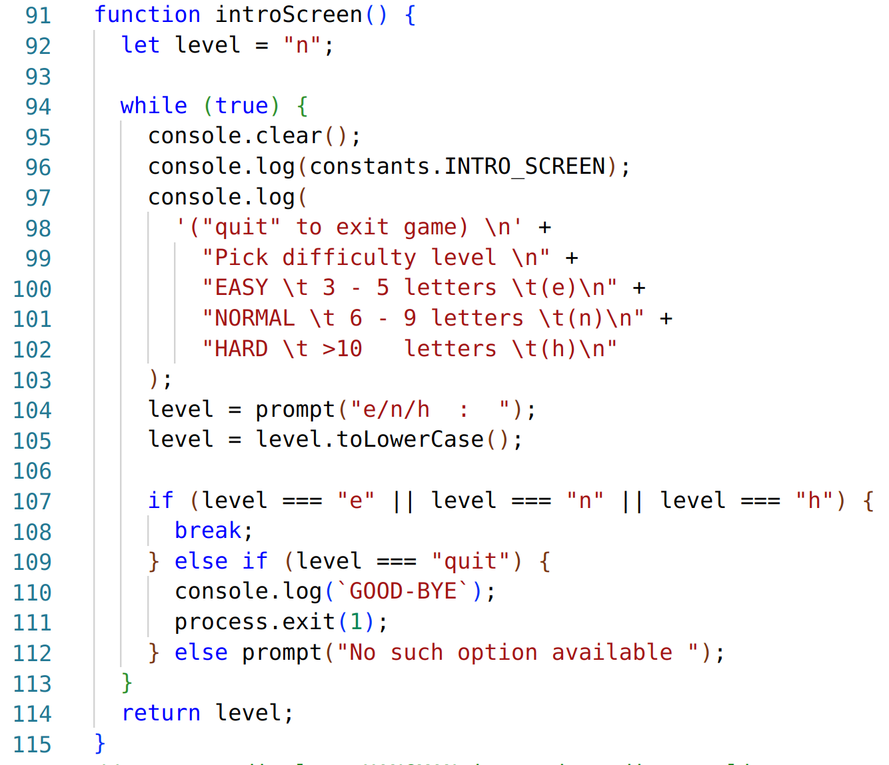
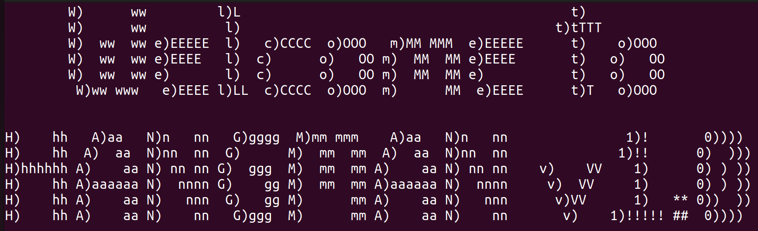
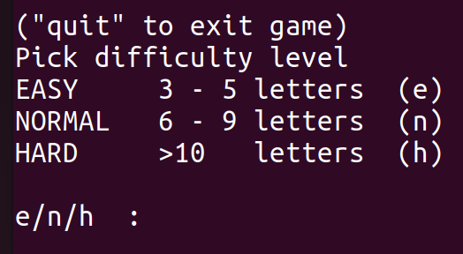
TeamWork project: Hangman
Friday, November 4th 2022
Slide <number>
Zinaida Jusufovic
Thomas Sicay

Slide 3
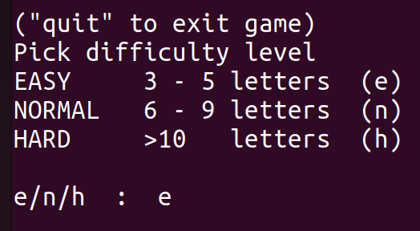
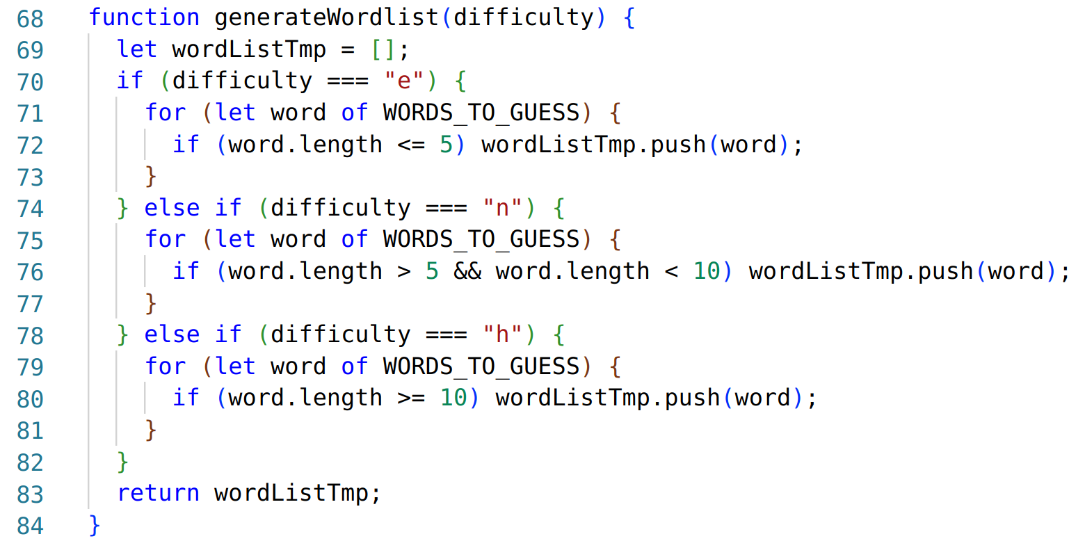
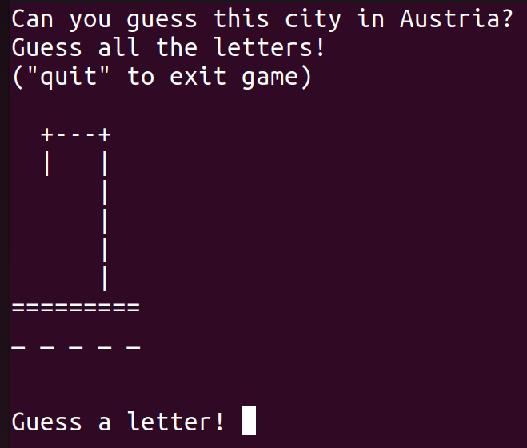
TeamWork project: Hangman
Friday, November 4th 2022
Slide <number>
Zinaida Jusufovic
Thomas Sicay

Slide 4
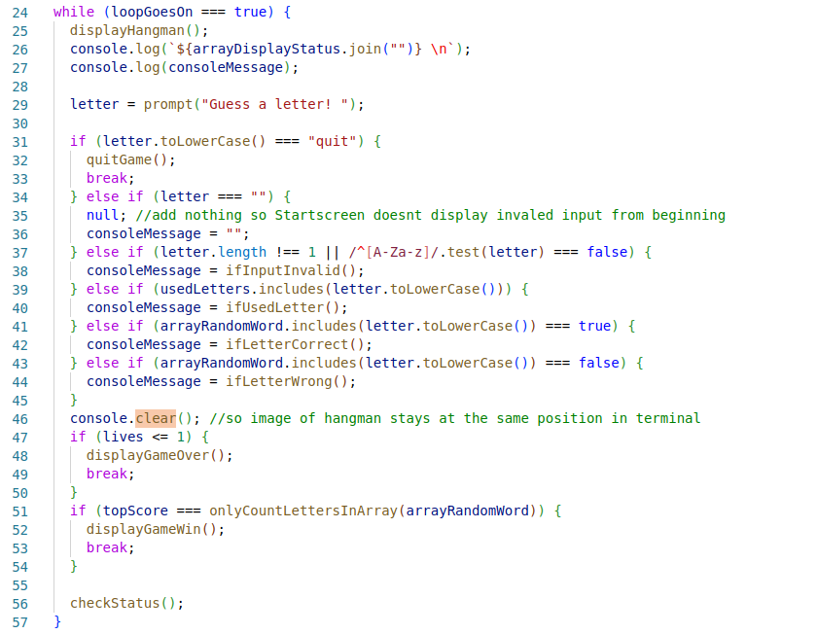
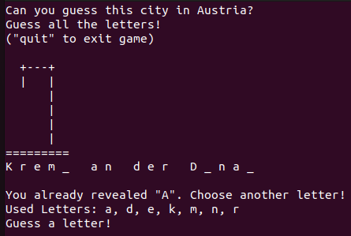
TeamWork project: Hangman
Friday, November 4th 2022
Slide <number>
Zinaida Jusufovic
Thomas Sicay

Slide 5
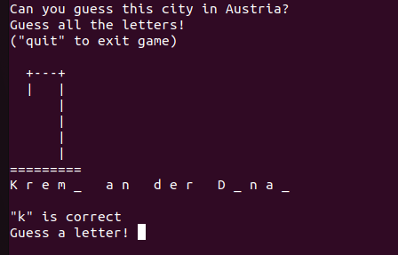
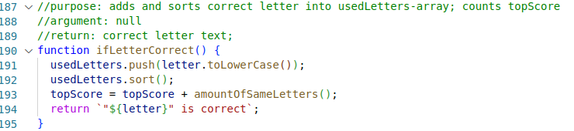
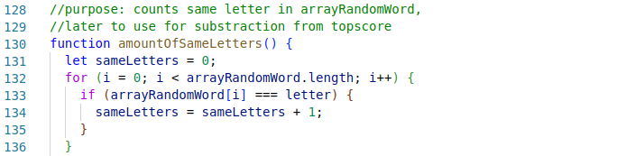
TeamWork project: Hangman
Friday, November 4th 2022
Slide <number>
Zinaida Jusufovic
Thomas Sicay

Slide 6
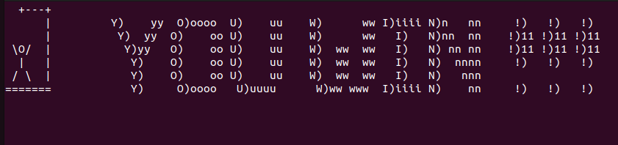

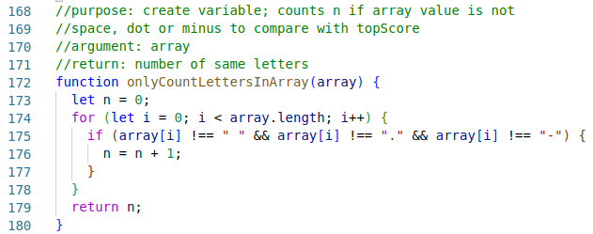
TeamWork project: Hangman
Friday, November 4th 2022
Slide <number>
Zinaida Jusufovic
Thomas Sicay

